Slide 1
Future Seekers – Business Analytics Nanodegree Program
Build Data Dashboards
Issa Alhilali
Future Seekers & Udacity
In this project we will uncover insights from a set of data visualized on a canvas.
It contains information about Departure delay flights and their reasons, as well as the airlines that canceled flights during 2015.
Visualize this data to create different types of control panels below

Slide 2
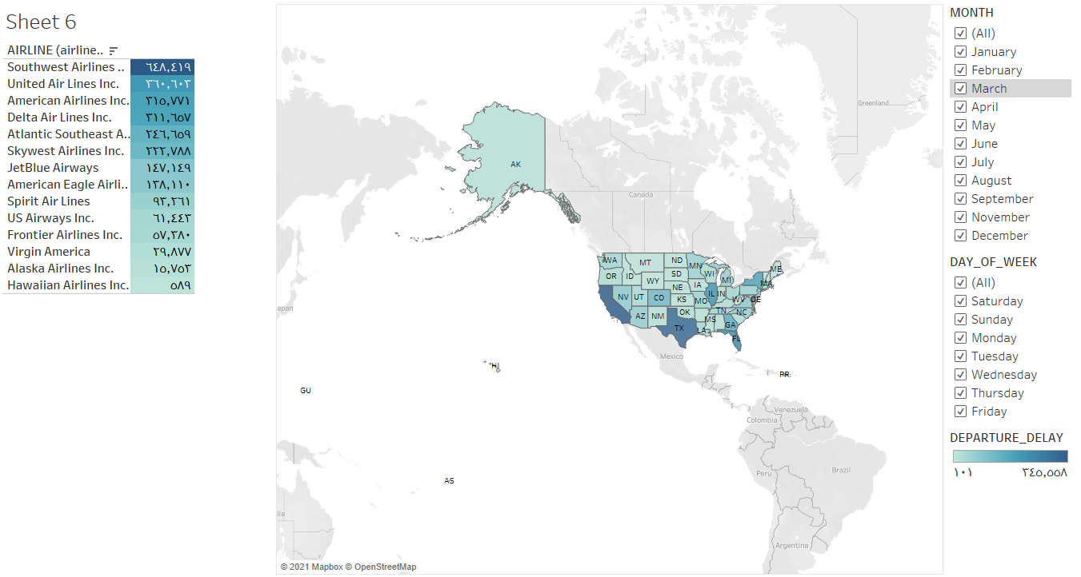
Airlines of flights the delayed in US states for the year 2015
Through the dashboard of the United States and the states shown in the map panel, the map and table for all months and days of the week show a variation in the states and in the number of companies that have delayed their flights, and the airline was witnessing the largest number of delayed southwest Airline flights, with an average of 648,419 flights, followed by United Air Lines with an average of 360,603 late flights, followed by the rest States in varying numbers.
The table and the map were chosen to make it clear for everyone with the appropriate color selection that shows the depth and openness of color and the consistency of the data with the map and table.
Link Dashboard:
https://public.tableau.com/profile/issa.alhali#!/vizhome/Airlineswhoseflightsaredelayed/CancellationDashboard?publish=yes

Slide 3
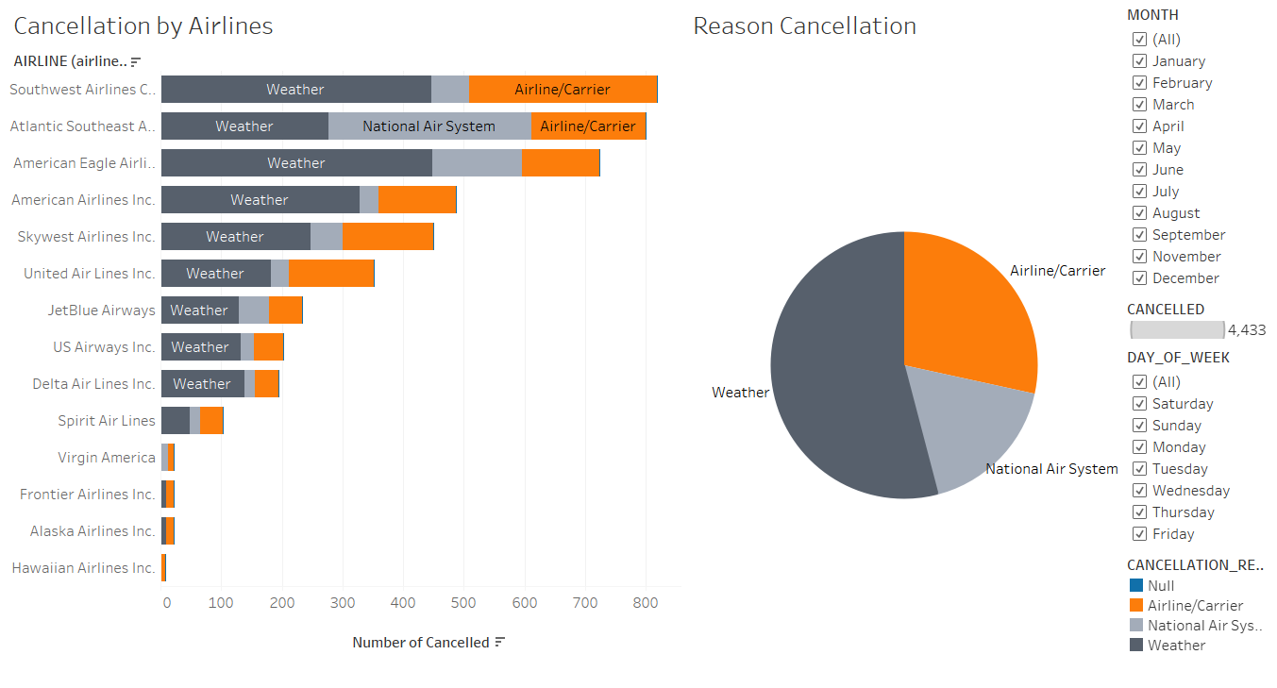
Cause and Airline of flight cancellation in 2015
The pie chart and the histogram bar for the airlines shows that the main reason for canceling flights is due to the cause of the weather, as the number of canceled flights in 2015 reached 2397 flights that were canceled, while the company southwest Airlines issued the most canceled flights, and this also follows among the reasons such as the company Aviation / carrier as well as the national air system.
Choose the horizontal bar and pie char to make the data clearer while choosing a color that corresponds to color blindness
Link Dashboard for Reason Cancellations:
https://public.tableau.com/profile/issa.alhali#!/vizhome/AirlinesofflightsthedelayedinUSstatesfortheyear2015/Dashboard2?publish=yes

Slide 4
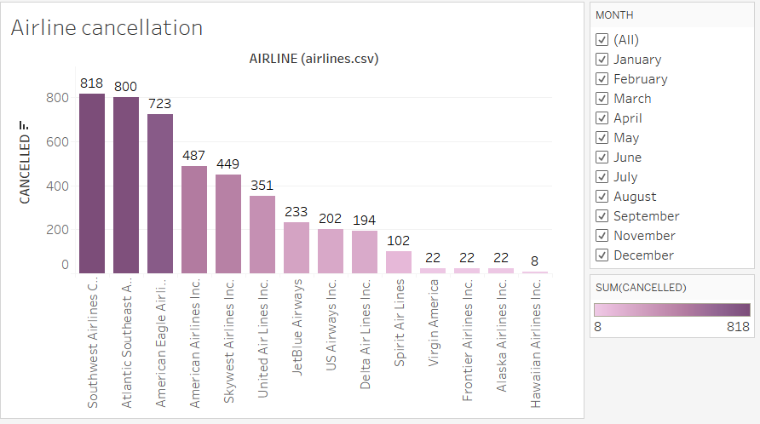
Airlines that canceled their flights in 2015
The chart shows most of the companies that canceled their flights during 2015, while the total number of companies that canceled their flights reached 14 companies, according to different companies, while Southwest Airlines topped with canceling 818 flights. Southeastern Atlantic Airlines followed by canceling 800 flights, while the companies remained varied in the number of canceled flights.
Choose a horizontal bar to make the data more accurate and describe with clear numbers and with a choice of color that corresponds to color blindness.
Link Dashboard for Airlines Cancellations:
https://public.tableau.com/profile/issa.alhali#!/vizhome/Airlienscancellation/Airlinecancellation?publish=yes

Slide 5
THE END

